Slide 1
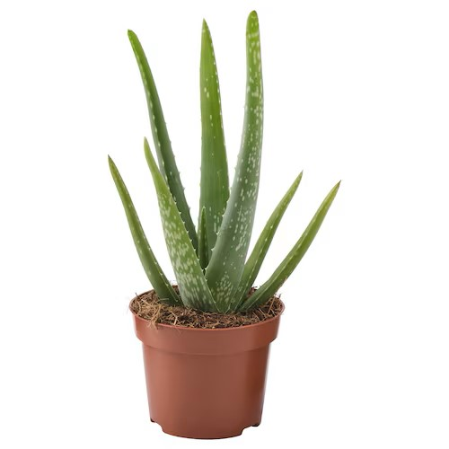
SnapGarden Final Presentation
Projektpraktikum Multimedia
Hayri Altinisik, ge47nij@tum.de
Baran Kilic, ge95bid@tum.de
Kenny Nguyen, ge47wof@tum.de

Slide 2
Project Idea
The Problem:
Beginners struggle to care and maintain healthy plants
Overwatering, pests, and lack of knowledge lead to plant failure
Seasoned Gardeners desire smarter tools
Our Motivation:
Empower plant lovers with AI-powered tools to make plant care effortless
Promote sustainability by encouraging successful plant cultivation
Bridge the gap between technology and nature for eco-conscious living

Slide 3
Key Features
Plant Identification:
Snap a photo of any plant, and our AI identifies it instantly
Provides information like plant type, ideal conditions, and common issues
Health Analysis:
Detect signs of pests, diseases, or poot health through photo analysis
Offers actionable advice for treatment and maintenance
Personalized Watering Schedules:
AI calculates the watering needs of each plant based on species
Sends reminders, so users never miss a watering day
User-Friendly Experience:
Easy-to-navigate interface with tips for beginners and tools for experienced gardeners
Works seamlessly across devices for on-the-go support.

Slide 4
Project Management, Task Distribution
Deep Learning (Baran Kilic)
Dataset Preparation
Trained the LLM model.
Backend (Hayri Altinisik):
Developed the logic for sign-in/sign-up processes and dashboard functionality
Frontend (Kenny Nguyen):
Implemented a website and a dashboard using templates.
Developed the logic for the chat function and plant identification.

Slide 5
Implementation & Challenges
Deep Learning
Which dataset?
Which model? Model Architecture?
Training process?
Performance?
Website
Frontend framework?
Backend framework? (Flask, or more?)
Did you encounter any challenges? How did you solve them?

Slide 6
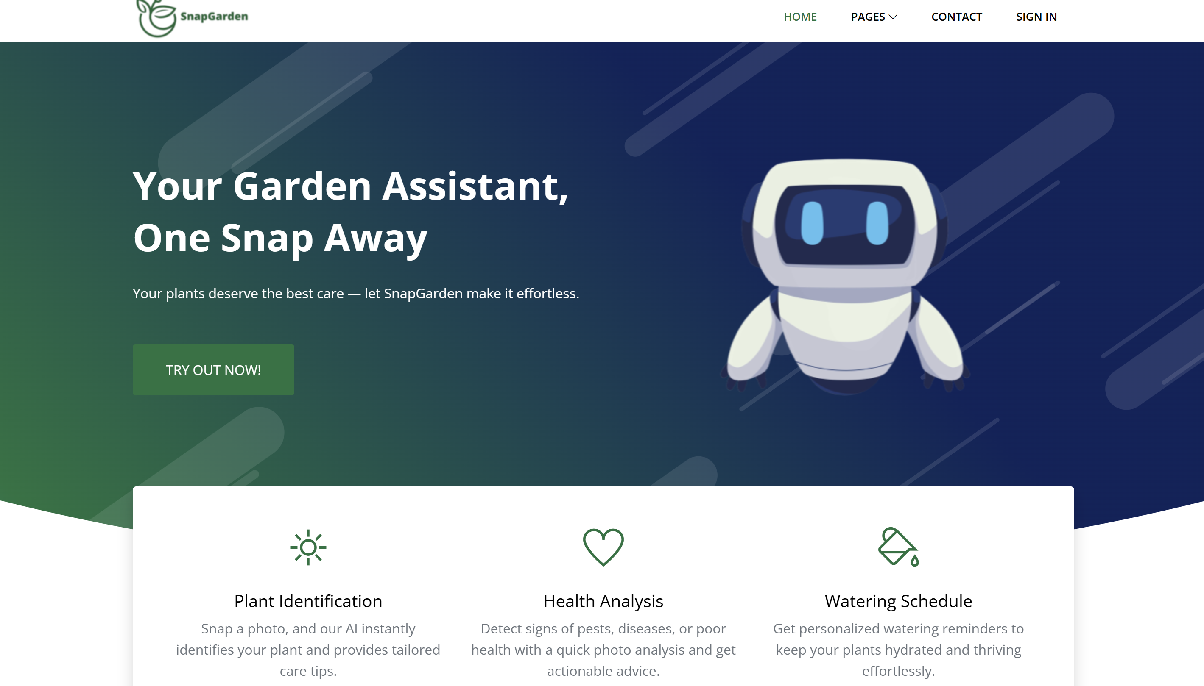
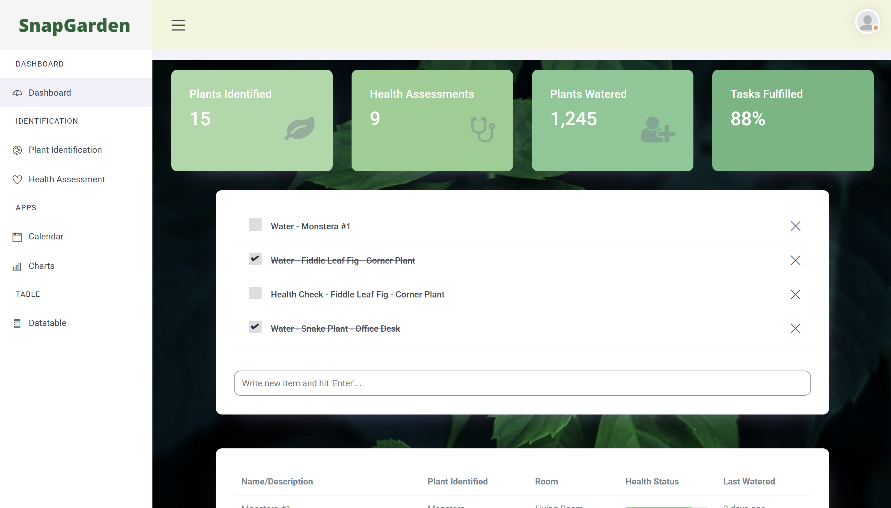
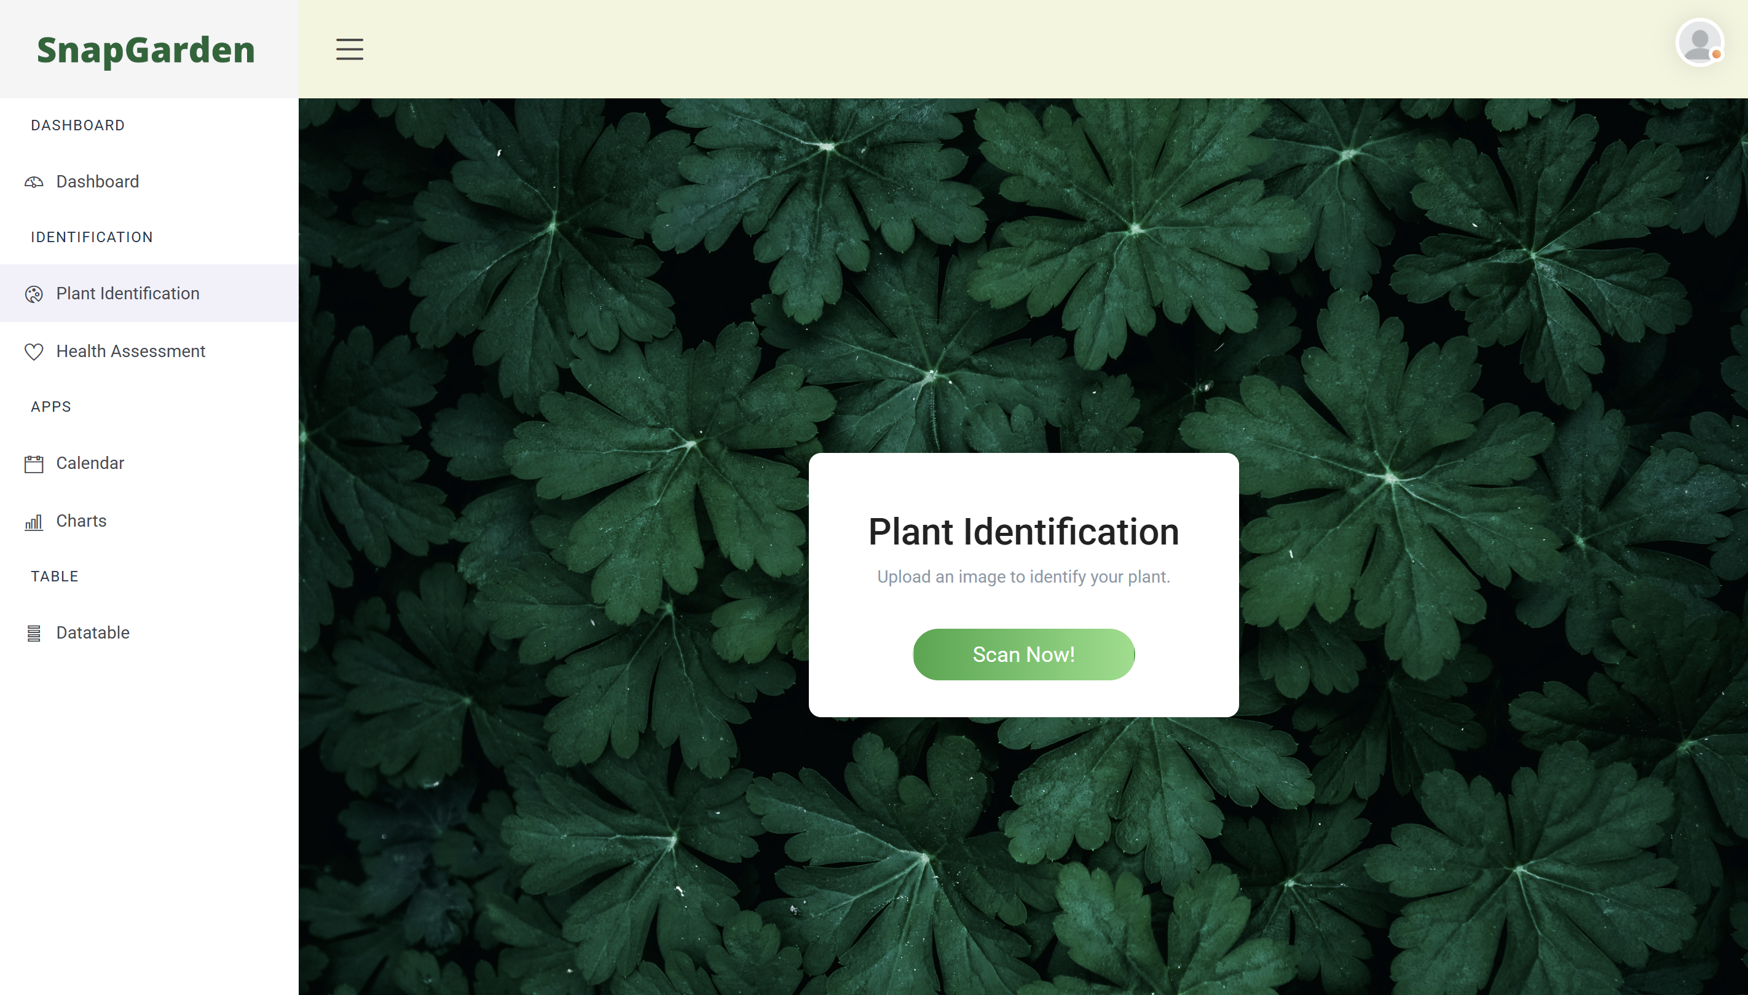
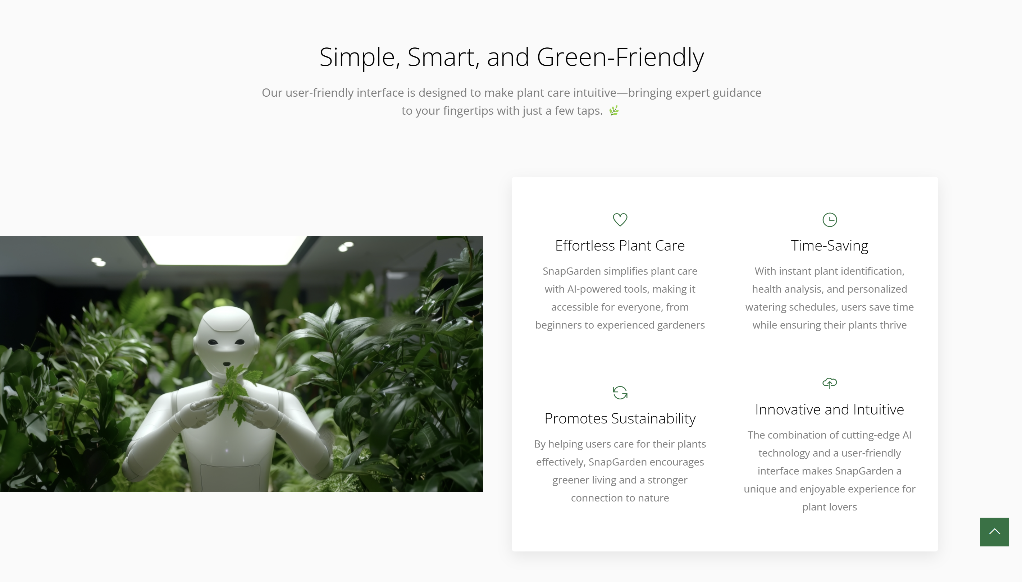

Slide 7
Demo

Slide 8
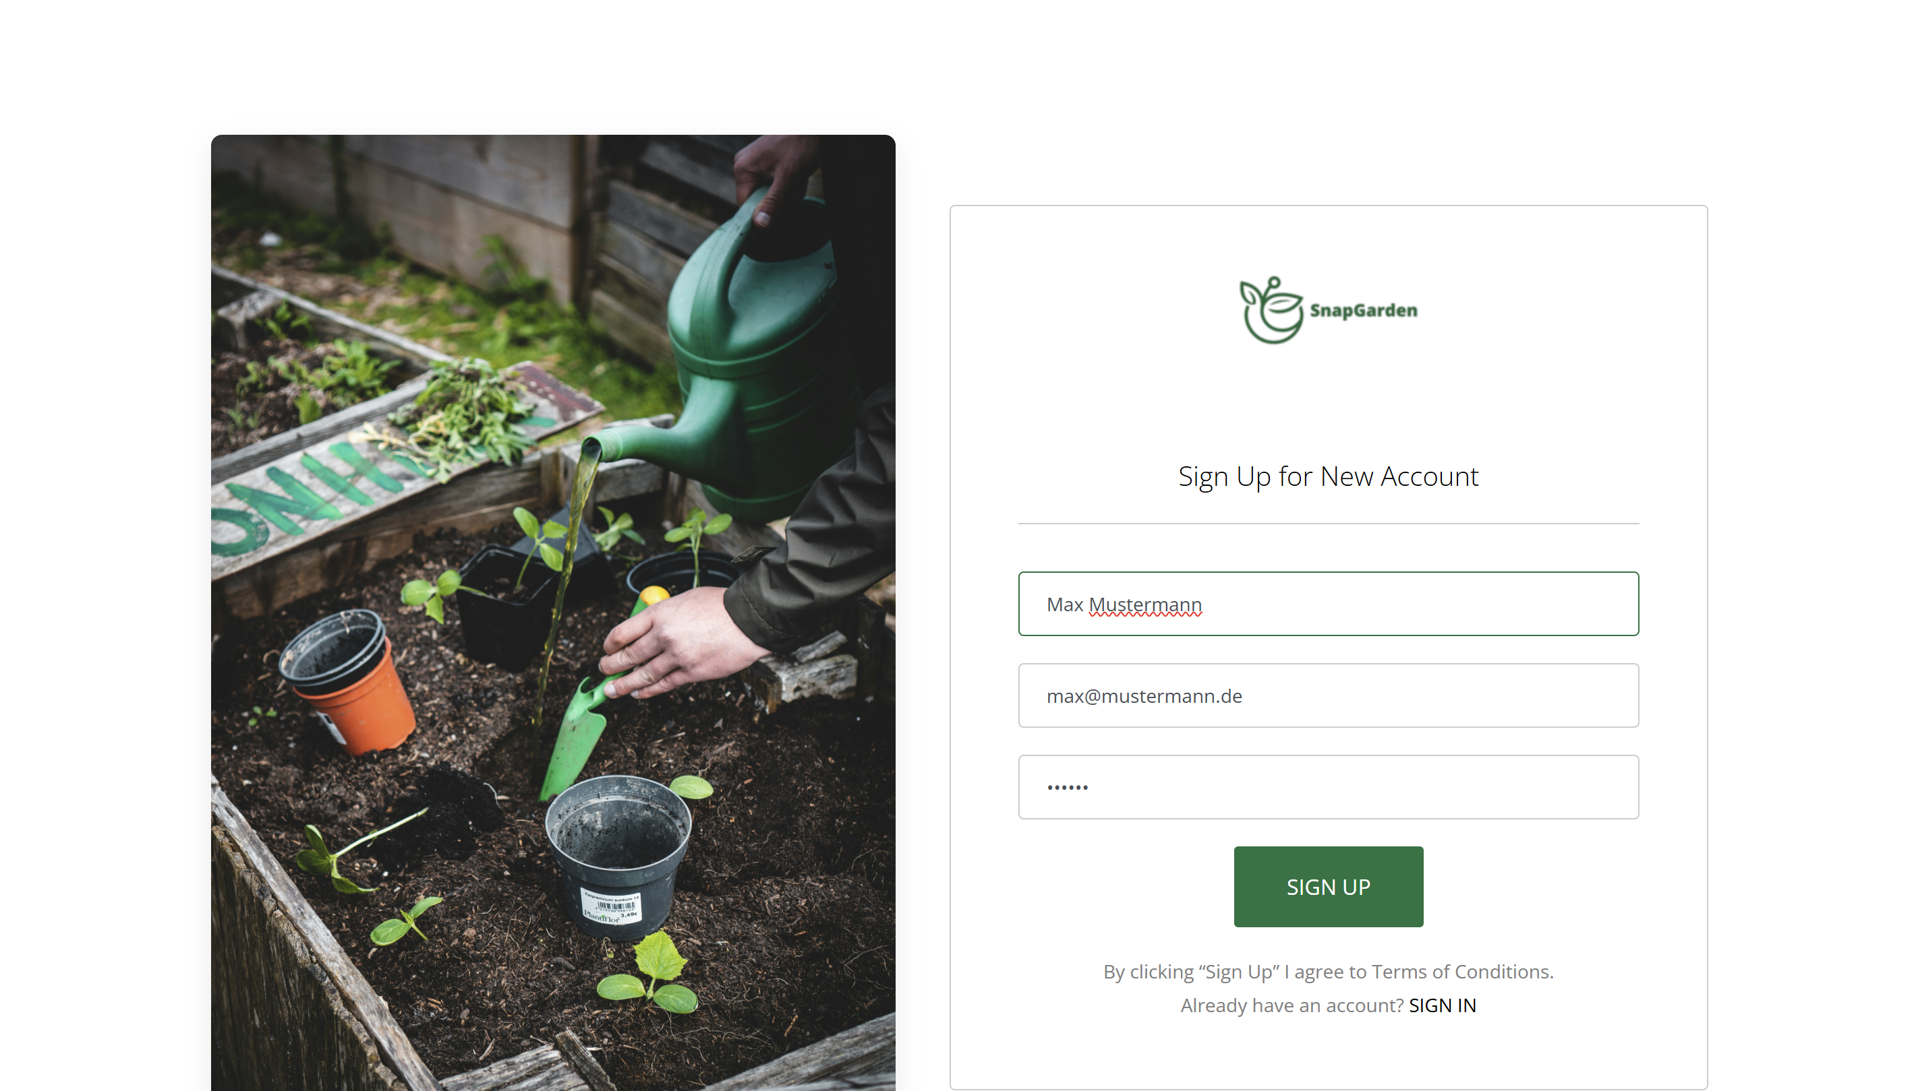
Demo

Slide 9
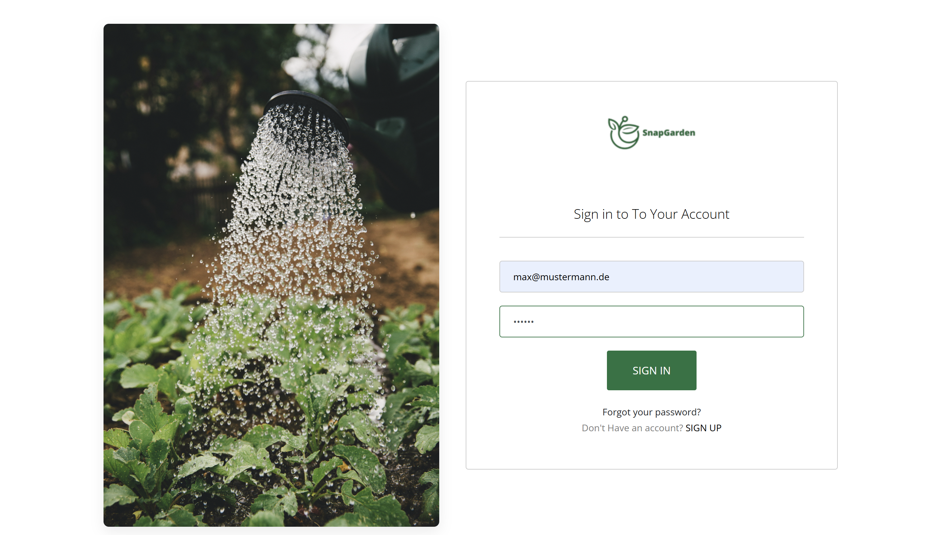
Demo

Slide 10
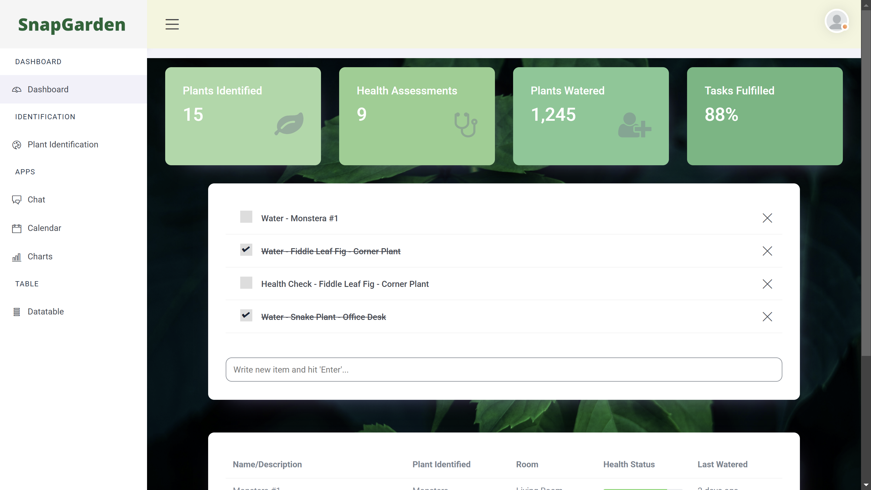
Demo

Slide 11
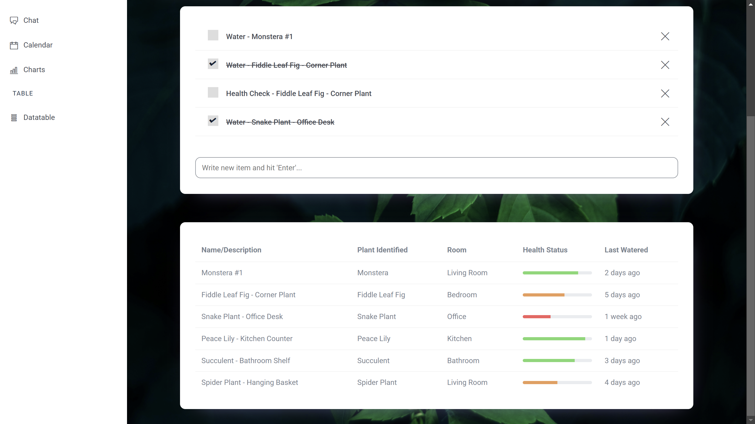
Demo

Slide 12
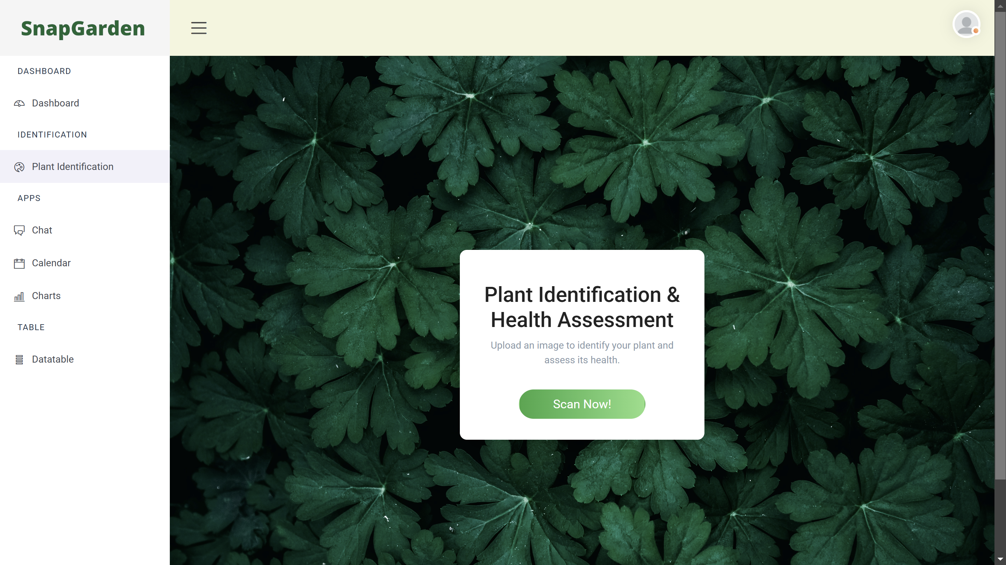
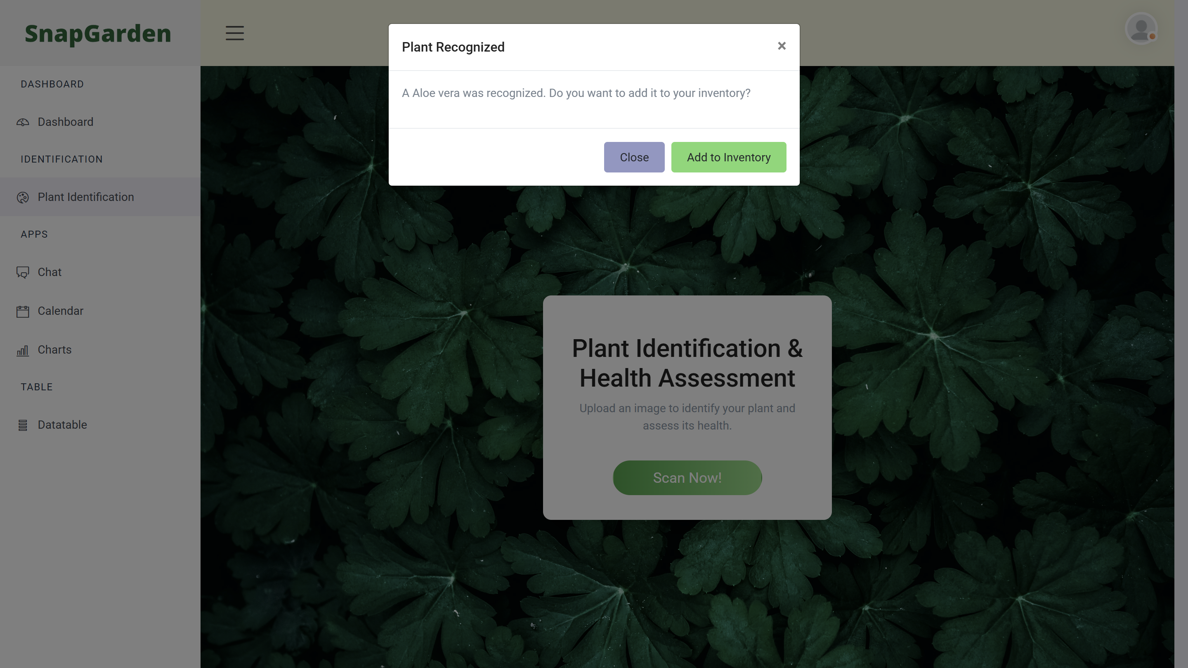

Demo

Slide 13
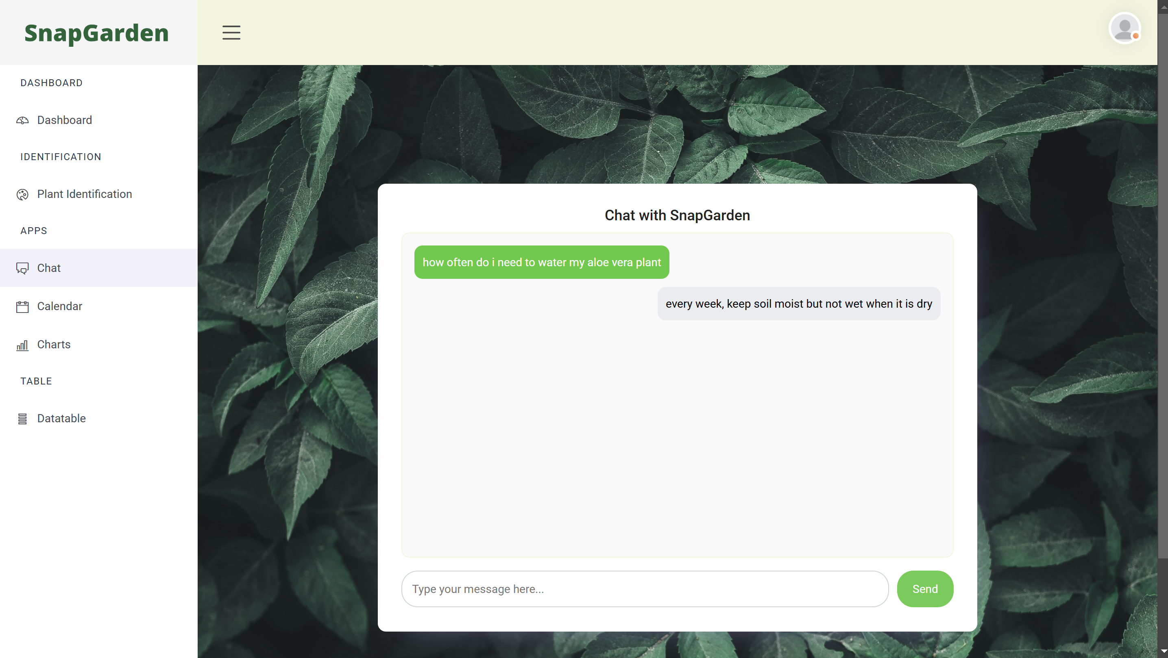
Demo

Slide 14
Goals & Milestones
Website
Dashboard
Plant Identification
Chat Function
Log in / Sign Up
Dashboard Logic
Statistics
“Accounts”
Website
Dashboard
Plant Identification
Chat Function
Log in / Sign Up
Dashboard Logic
Statistics
“Accounts”

Slide 15
Conclusion

Slide 16
References
Templates for Frontend
https://themefisher.com/products/quixlab-bootstrap
https://themefisher.com/products/small-apps-bootstrap

Slide 17
Thank you for your attention

